Slide 1
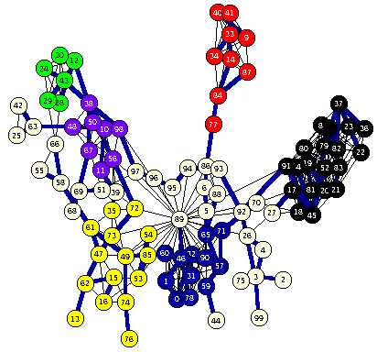
Constraint Satisfaction
Problem
Russell & Norvig Ch. 6

Slide 2
Overview
Constraint satisfaction adalah satu problem tersendiri di dalam AI.
  Problem: satu set variabel yang harus diisi sengan nilai tertentu dengan memenuhi constrain tertentu.
  Constraint programming, constraint satisfaction problems (CSPs), constraint logic programming…
Algorithms untuk CSPs
  Backtracking (systematic search)
  Constraint propagation (k-consistency)
  Variable and value ordering heuristics
  Backjumping and dependency-directed backtracking

Slide 3
Contoh sederhana: 8 Queens
Tempatkan 8 ratu pada papan catur pada posisi tertentu sehingga ratu-ratu tersebut tidak saling menyerang
'Generate-and-test', ada
8⁸ combinations
8**8 is 16,777,216

Slide 4
Contoh sederhana: 8 Queens
Sesudah menempatkan 2 queen, sangat trivial untuk menentukan kotak dimana queen sudah tidak bisa dipakai lagi.

Slide 5
8 queens bukan searching biasa ?
Bukan hanya soal successor function dan goal test
Tetapi juga
  cara untuk memasukkan constrains dari satu level queen ke yang lain
  test kesalahan dini
Representasi explicit dari constrain dan manipulasinya.

Slide 6
definisi "informal" CSP
CSP = Constraint Satisfaction Problem, diberikan:
  (1) himpunan terbatas dari variable
  (2) masing-masing dengan domain dari nilai yang mungkin (sering kali terbatas)
  (3) constraints yang membatasi nilai variable
Solution adalah susunan dari nilai-nilai yang dimasukkan pada variable yang memenuhi constrain yang diberikan.
apakah solusi tersebut ada? temukan !, temukan semuanya ! temukan solusi terbaik menurut satu ukuran tertentu (objective function).

Slide 7
Example: 8-Queens Problem
Eight variables Xi, i = 1..8 where Xi is the row number of queen in column i
Domain for each variable {1,2,…,8}
Constraints are of the forms:
  Not on same row:
  Xi = k ➔ Xj ≠ k for j = 1..8, j≠i
  Not on same diagonal
  Xi = ki, Xj = kj ➔|i-j| ≠| ki - kj| for j = 1..8, j≠i

Slide 8
Example: Task Scheduling
T1
T2
T4
T3
Examples of scheduling constraints:
T1 must be done during T3
T2 must be achieved before T1 starts
T2 must overlap with T3
T4 must start after T1 is complete

Slide 9
Contoh: Map coloring
Warnai peta berikut ini dengan 3 warna berbeda (red, green, blue) tetepi tidak ada 2 region yang berdekatan mempunyai warna yang sama.
E
D
A
B
C

Slide 10
Map coloring
Variables: A, B, C, D, E all of domain RGB
Domains: RGB = {red, green, blue}
Constraints: A≠B, A≠C,A ≠ E, A ≠ D, B ≠ C, C ≠ D, D ≠ E
A solution: A=red, B=green, C=blue, D=green, E=blue
E
E
D
A
B
=>
D
A
B
C
C

Slide 11
Brute Force methods
Finding a solution by a brute force search is easy
  Generate and test is a weak method
  Just generate potential combinations and test each
Potentially very inefficient
  With n variables where each can have one of 3 values, there are 3^{n} possible solutions to check
There are ~190 countries in the world, which we can color using four colors
4¹⁹⁰ is a big number!
solve(A,B,C,D,E) :-
color(A),
color(B),
color(C),
color(D),
color(E),
not(A=B),
not(A=B),
not(B=C),
not(A=C),
not(C=D),
not(A=E),
not(C=D).
color(red).
color(green).
color(blue).
4**190 is 2462625387274654950767440006258975862817483704404090416746768337765357610718575663213391640930307227550414249394176L

Slide 12
Example: SATisfiability
Given a set of propositions containing variables, find an assignment of the variables to {false, true} that satisfies them.
For example, the clauses:
  (A ∨ B ∨ ¬C) ∧ ( ¬A ∨ D)
  (equivalent to (C → A) ∨ (B ∧ D → A)
are satisfied by
  A = false, B = true, C = false, D = false
Satisfiability is known to be NP-complete, so in the worst case, solving CSP problems requires exponential time

Slide 13
Real-world problems
CSPs are a good match for many practical problems that arise in the real world
Scheduling
Temporal reasoning
Building design
Planning
Optimization/satisfaction
Vision
Graph layout
Network management
Natural language processing
Molecular biology / genomics
VLSI design

Slide 14
Definition of a constraint network (CN)
A constraint network (CN) consists of
a set of variables X = {x₁, x₂, … x_{n}}
  each with associated domain of values {d₁,d₂,…d_{n}}
  domains are typically finite
a set of constraints {c₁, c₂ … c_{m}} where
  each defines a predicate which is a relation over a particular subset of variables (X)
  e.g., C_{i} involves variables {X_{i1}, X_{i2}, … X_{ik}} and defines the relation R_{i} ⊆ D_{i1} x D_{i2} x … D_{ik}

Slide 15

Running example: coloring Australia
NT
Q
WA
SA
NSW
V
T
Seven variables: {WA,NT,SA,Q,NSW,V,T}
Each variable has the same domain: {red, green, blue}
No two adjacent variables have the same value:
WA≠NT, WA≠SA, NT≠SA, NT≠Q, SA≠Q, SA≠NSW,
SA≠V,Q≠NSW, NSW≠V

Slide 16
Unary & binary constraints most common
Binary constraints
T1
NT
Q
WA
T2
T4
SA
NSW
T3
V
T
Two variables are adjacent or neighbors if
connected by an edge or an arc
Possible to rewrite problems with higher-order
constraints as ones with just binary constraints
  Reification

Slide 17
Formal definition of a CN
Instantiations
  An instantiation of a subset of variables S is an assignment of a value in its domain to each variable in S
  An instantiation is legal iff it does not violate any constraints
A solution is an instantiation of all of the variables in the network

Slide 18
Typical tasks for CSP
Solution related tasks:
  Does a solution exist?
  Find one solution
  Find all solutions
  Given a metric on solutions, find the best one
  Given a partial instantiation, do any of the above
Transform the CN into an equivalent CN that is easier to solve

Slide 19
Binary CSP
A binary CSP is a CSP where all constraints are binary or unary
Any non-binary CSP can be converted into a binary CSP by introducing additional variables
A binary CSP can be represented as a constraint graph, with a node for each variable and an arc between two nodes iff there’s a constraint involving the two variables
  Unary constraints appear as self-referential arcs

Slide 20
Running example: coloring Australia
NT
Q
WA
SA
NSW
V
T
Seven variables: {WA,NT,SA,Q,NSW,V,T}
Each variable has the same domain: {red, green, blue}
No two adjacent variables have the same value:
WA≠NT, WA≠SA, NT≠SA, NT≠Q, SA≠Q, SA≠NSW,
SA≠V,Q≠NSW, NSW≠V

Slide 21

A running example: coloring Australia
NT
Q
WA
SA
NSW
V
T
Solutions are complete and consistent assignments
One of several solutions
Note that for generality, constraints can be expressed as relations, e.g., WA ≠ NT is
  (WA,NT) in {(red,green), (red,blue), (green,red), (green,blue), (blue,red),(blue,green)}

Slide 22

Backtracking example

Slide 23

Backtracking example

Slide 24

Backtracking example

Slide 25

Backtracking example

Slide 26
Basic Backtracking Algorithm
CSP-BACKTRACKING(PartialAssignment a)
  If a is complete then return a
  X ← select an unassigned variable
  D ← select an ordering for the domain of X
  For each value v in D do
    If v is consistent with a then
      Add (X= v) to a
      result ← CSP-BACKTRACKING(a)
      If result ≠ failure then return result
      Remove (X= v) from a
  Return failure
Start with CSP-BACKTRACKING({})
Note: this is depth first search; can solve n-queens problems for n ~ 25

Slide 27
Problems with backtracking
Thrashing: keep repeating the same failed variable assignments
Things that can help avoid this:
  Consistency checking
  Intelligent backtracking schemes
Inefficiency: can explore areas of the search space that aren’t likely to succeed
  Variable ordering can help

Slide 28
Improving backtracking efficiency
Here are some standard techniques to improve the efficiency of backtracking
  Can we detect inevitable failure early?
  Which variable should be assigned next?
  In what order should its values be tried?

Slide 29
Forward Checking
After a variable X is assigned a value v, look at each unassigned variable Y connected to X by a constraint and delete from Y’s domain values inconsistent with v
Using forward checking and backward checking roughly doubles the size of N-queens problems that can be practically solved

Slide 30

Forward checking
Keep track of remaining legal values for unassigned variables
Terminate search when any variable has no legal values

Slide 31

Forward checking

Slide 32

Forward checking

Slide 33

Forward checking

Slide 34
Constraint propagation
Forward checking propagates info.
from assigned to unassigned variables, but doesn't provide early detection for all failures
NT and SA cannot both be blue!

Slide 35
Definition: Arc consistency
A constraint C_xy is arc consistent wrt x if for each value v of x there is an allowed value of y
Similarly define C_xy as arc consistent wrt y
A binary CSP is arc consistent iff every constraint C_xy is arc consistent wrt x as well as y
When a CSP is not arc consistent, we can make it arc consistent, e.g., by using AC3
  This is also called “enforcing arc consistency”

Slide 36
Arc Consistency Example
Domains
  D_x = {1, 2, 3}
  D_y = {3, 4, 5, 6}
Constraint
  C_xy = {(1,3), (1,5), (3,3), (3,6)}
C_xy is not arc consistent wrt x, neither wrt y. By enforcing arc consistency, we get reduced domains
  D'_x = {1, 3}
  D'_y={3, 5, 6}

Slide 37

Arc consistency
Simplest form of propagation makes each arc consistent
X →Y is consistent iff for every value x of X there is some allowed y

Slide 38

Arc consistency
Simplest form of propagation makes each arc consistent
X →Y is consistent iff for every value x of X there is some allowed y

Slide 39

Arc consistency
If X loses a value, neighbors of X need to be rechecked

Slide 40

Arc consistency
Arc consistency detects failure earlier than simple forward checking
Can be run as a preprocessor or after each assignment

Slide 41
General CP for Binary Constraints
Algorithm AC3
contradiction ← false
Q ← stack of all variables
while Q is not empty and not contradiction do
  X ← UNSTACK(Q)
  For every variable Y adjacent to X do
    If REMOVE-ARC-INCONSISTENCIES(X,Y)
      If domain(Y) is non-empty then STACK(Y,Q)
      else return false

Slide 42
Complexity of AC3
e = number of constraints (edges)
d = number of values per variable
Each variable is inserted in Q up to d times
REMOVE-ARC-INCONSISTENCY takes O(d²) time
CP takes O(ed³) time

Slide 43
Improving backtracking efficiency
Here are some standard techniques to improve the efficiency of backtracking
  Can we detect inevitable failure early?
  Which variable should be assigned next?
  In what order should its values be tried?
Combining constraint propagation with these heuristics makes 1000 N-queen puzzles feasible

Slide 44

Most constrained variable
Most constrained variable:
  choose the variable with the fewest legal values
a.k.a. minimum remaining values (MRV) heuristic
After assigning a value to WA, NT and SA have only two values in their domains – choose one of them rather than Q, NSW, V or T

Slide 45

Most constraining variable
Tie-breaker among most constrained variables
Choose variable involved in largest # of constraints on remaining variables
After assigning SA to be blue, WA, NT, Q, NSW and V all have just two values left.
WA and V have only one constraint on remaining variables and T none, so choose one of NT, Q & NSW

Slide 46

Least constraining value
Given a variable, choose least constraining value:
  the one that rules out the fewest values in the remaining variables
Combining these heuristics makes 1000 queens feasible
What’s an intuitive explanation for this?

Slide 47
Is AC3 Alone Sufficient?
Consider the four queens problem
X1
{1,2,3,4}
X2
{1,2,3,4}
1
2
3
4
1
2
3
4
X3
{1,2,3,4}
X4
{1,2,3,4}

Slide 48
Solving a CSP still requires search
Search:
  can find good solutions, but must examine non-solutions along the way
Constraint Propagation:
  can rule out non-solutions, but this is not the same as finding solutions
Interweave constraint propagation & search:
  Perform constraint propagation at each search step

Slide 49
1
2
3
4
1
2
3
4
1
2
3
4
1
2
3
4
1
2
3
4
1
1
1
2
2
2
3
3
3
4
4
4

Slide 50
4-Queens Problem
X1
{1,2,3,4}
X2
{1,2,3,4}
1
2
3
4
1
2
3
4
X3
{1,2,3,4}
X4
{1,2,3,4}

Slide 51
4-Queens Problem
X1
{1,2,3,4}
X2
{1,2,3,4}
1
2
3
4
1
2
3
4
X3
{1,2,3,4}
X4
{1,2,3,4}

Slide 52
4-Queens Problem
X1
{1,2,3,4}
X2
{1,2,3,4}
1
2
3
4
1
2
3
4
X3
{1,2,3,4}
X4
{1,2,3,4}
X2=3 eliminates { X3=2, X3=3, X3=4 }
⇒ inconsistent!

Slide 53
4-Queens Problem
X1
{1,2,3,4}
X2
{1,2,3,4}
1
2
3
4
1
2
3
4
X3
{1,2,3,4}
X4
{1,2,3,4}
X2=4 ⇒ X3=2, which eliminates { X4=2, X4=3}
⇒ inconsistent!

Slide 54
4-Queens Problem
X1
{1,2,3,4}
X2
{1,2,3,4}
1
2
3
4
1
2
3
4
X3
{1,2,3, }
X4
{1,2,3,4}
X3=2 eliminates { X4=2, X4=3}
⇒ inconsistent!

Slide 55
4-Queens Problem
X1
{1,2,3,4}
X2
{1,2,3,4}
1
2
3
4
1
2
3
4
X3
{1,2,3,4}
X4
{1,2,3,4}

Slide 56
4-Queens Problem
X1
{1,2,3,4}
X2
{1,2,3,4}
1
2
3
4
1
2
3
4
X3
{1,2,3,4}
X4
{1,2,3,4}

Slide 57
4-Queens Problem
X1
{1,2,3,4}
X2
{1,2,3,4}
1
2
3
4
1
2
3
4
X3
{1,2,3,4}
X4
{1,2,3,4}
Can we eliminate any other values?

Slide 58
4-Queens Problem
X1
{1,2,3,4}
X2
{1,2,3,4}
1
2
3
4
1
2
3
4
X3
{1,2,3,4}
X4
{1,2,3,4}

Slide 59
4-Queens Problem
X1
{1,2,3,4}
X2
{1,2,3,4}
1
2
3
4
1
2
3
4
X3
{1,2,3,4}
X4
{1,2,3,4}

Slide 60
4-Queens Problem
X1
{1,2,3,4}
X2
{1,2,3,4}
1
2
3
4
1
2
3
4
X3
{1,2,3,4}
X4
{1,2,3,4}

Slide 61
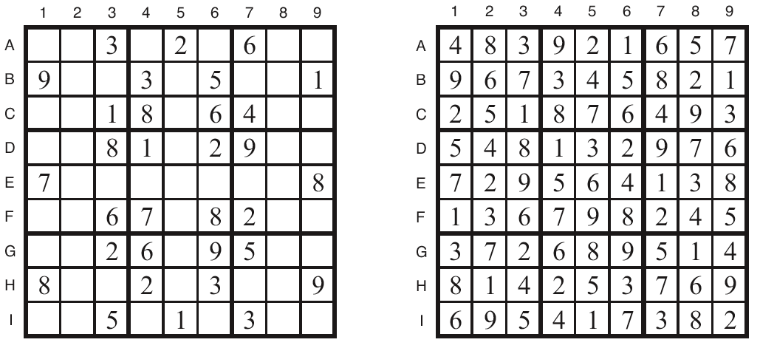
Sudoku Example
How can we set this up as a CSP?

Slide 62
Sudoku
Digit placement puzzle on 9x9 grid with unique answer
Given an initial partially filled grid, fill remaining squares with a digit between 1 and 9
Each column, row, and nine 3×3 sub-grids must contain all nine digits
Some initial configurations are easy to solve and some very difficult

Slide 63
def sudoku(initValue):
p = Problem()
# Define a variable for each cell: 11,12,13...21,22,23...98,99
for i in range(1, 10) :
p.addVariables(range(i*10+1, i*10+10), range(1, 10))
# Each row has different values
for i in range(1, 10) :
p.addConstraint(AllDifferentConstraint(), range(i*10+1, i*10+10))
# Each colum has different values
for i in range(1, 10) :
p.addConstraint(AllDifferentConstraint(), range(10+i, 100+i, 10))
# Each 3x3 box has different values
p.addConstraint(AllDifferentConstraint(), [11,12,13,21,22,23,31,32,33])
p.addConstraint(AllDifferentConstraint(), [41,42,43,51,52,53,61,62,63])
p.addConstraint(AllDifferentConstraint(), [71,72,73,81,82,83,91,92,93])
p.addConstraint(AllDifferentConstraint(), [14,15,16,24,25,26,34,35,36])
p.addConstraint(AllDifferentConstraint(), [44,45,46,54,55,56,64,65,66])
p.addConstraint(AllDifferentConstraint(), [74,75,76,84,85,86,94,95,96])
p.addConstraint(AllDifferentConstraint(), [17,18,19,27,28,29,37,38,39])
p.addConstraint(AllDifferentConstraint(), [47,48,49,57,58,59,67,68,69])
p.addConstraint(AllDifferentConstraint(), [77,78,79,87,88,89,97,98,99])
# add unary constraints for cells with initial non-zero values
for i in range(1, 10) :
for j in range(1, 10):
value = initValue[i-1][j-1]
if value:
p.addConstraint(lambda var, val=value: var == val, (i*10+j,))
return p.getSolution()
# Sample problems
easy = [
[0,9,0,7,0,0,8,6,0],
[0,3,1,0,0,5,0,2,0],
[8,0,6,0,0,0,0,0,0],
[0,0,7,0,5,0,0,0,6],
[0,0,0,3,0,7,0,0,0],
[5,0,0,0,1,0,7,0,0],
[0,0,0,0,0,0,1,0,9],
[0,2,0,6,0,0,0,5,0],
[0,5,4,0,0,8,0,7,0]]
hard = [
[0,0,3,0,0,0,4,0,0],
[0,0,0,0,7,0,0,0,0],
[5,0,0,4,0,6,0,0,2],
[0,0,4,0,0,0,8,0,0],
[0,9,0,0,3,0,0,2,0],
[0,0,7,0,0,0,5,0,0],
[6,0,0,5,0,2,0,0,1],
[0,0,0,0,9,0,0,0,0],
[0,0,9,0,0,0,3,0,0]]
very_hard = [
[0,0,0,0,0,0,0,0,0],
[0,0,9,0,6,0,3,0,0],
[0,7,0,3,0,4,0,9,0],
[0,0,7,2,0,8,6,0,0],
[0,4,0,0,0,0,0,7,0],
[0,0,2,1,0,6,5,0,0],
[0,1,0,9,0,5,0,4,0],
[0,0,8,0,2,0,7,0,0],
[0,0,0,0,0,0,0,0,0]]

Slide 64
Local search for constraint problems
Remember local search?
A version of local search exists for constraint problems
Basic idea:
  generate a random “solution”
  Use metric of “number of conflicts”
  Modifying solution by reassigning one variable at a time to decrease metric until a solution is found or no modification improves it
Has all the features and problems of local search

Slide 65
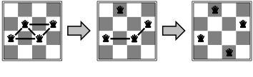
Min Conflict Example
States: 4 Queens, 1 per column
Operators: Move queen in its column
Goal test: No attacks
Evaluation metric: Total number of attacks
How many conflicts does each state have?

Slide 66
Basic Local Search Algorithm
Assign a domain value d_{i} to each variable v_{i}
while no solution & not stuck & not timed out:
bestCost ← ∞; bestList ← ∅;
for each variable v_{i} | Cost(Value(v_{i}) > 0
for each domain value d_{i} of v_{i}
if Cost(d_{i}) < bestCost
bestCost ← Cost(d_{i}); bestList ← d_{i};
else if Cost(d_{i}) = bestCost
bestList ← bestList ∪ d_{i}
Take a randomly selected move from bestList

Slide 67
Eight Queens using Backtracking
Backtrack and
undo last move
for Queen 4
Try next value
for Queen 5
Still Stuck
Undo move
for Queen 5
no move left
Try next value
for Queen 4
Undo move
for Queen 7
and so on...
Try Queen 1
Try Queen 5
Try Queen 6
Try Queen 2
Try Queen 3
Try Queen 4
Try Queen 5
Stuck!
Undo move
for Queen 5
Try Queen 7
Stuck Again

Slide 68
Eight Queens using Local Search
Place 8 Queens
randomly on
the board
Answer Found
Pick a Queen:
Calculate cost
of each move
Take least cost
move then try
another Queen
3
2
2
1
1
1
3
0
3
2
1
1
2
2
3
4
3
1
2
2
2
2
2
1
3
1
2
2
3
1
1
2
1
3
2
3
3
1
4
1
5
1
0
1
1
4
1
3
1
1
4
1
3
0
1
4
1
4
1
4
1
1
2
3
3
2
3
1
1
3
1
4
3
2
1
3
1
3
4
2
2
1
2
3
3
2
3
0
2
2
2
2
3
2
2
3
2
2
2
4
1
2
1
3
3
1
2
2
1
2
3
3
1
2
1

Slide 69
Backtracking Performance
5000
4000
3000
Time in seconds
2000
1000
0
0
4
8
12
16
20
24
28
32
Number of Queens

Slide 70
Local Search Performance
2500
2000
1500
Time in seconds
1000
500
0
0
5000
10000
15000
20000
Number of Queens

Slide 71
Min Conflict Performance
Performance depends on quality and informativeness of initial assignment; inversely related to distance to solution
Min Conflict often has astounding performance
For example, it’s been shown to solve arbitrary size (in the millions) N-Queens problems in constant time.
This appears to hold for arbitrary CSPs with the caveat…

Slide 72
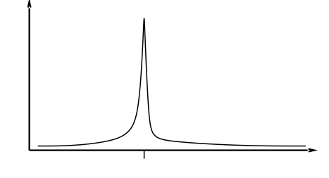
Min Conflict Performance
Except in a certain critical range of the ratio constraints to variables.

Slide 73
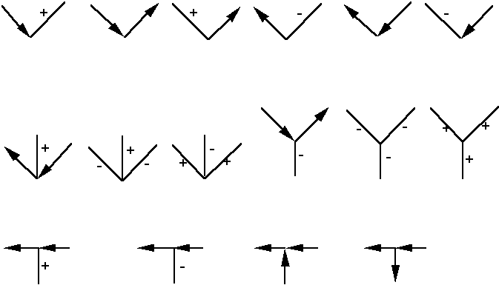
Famous example: labeling line drawings
Waltz labeling algorithm – earliest AI CSP application
  Convex interior lines are labeled as +
  Concave interior lines are labeled as –
  Boundary lines are labeled as
There are 208 labeling (most of which are impossible)
Here are the 18 legal labeling:

Slide 74
Labeling line drawings II
Here are some illegal labelings:
-
-
+
+
-

Slide 75
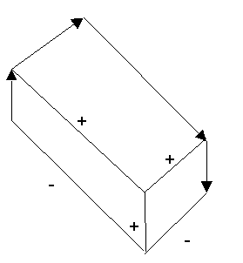

Labeling line drawings
Waltz labeling algorithm: propagate constraints repeatedly until a solution is found
A solution for one labeling problem
A labeling problem with no solution

Slide 76
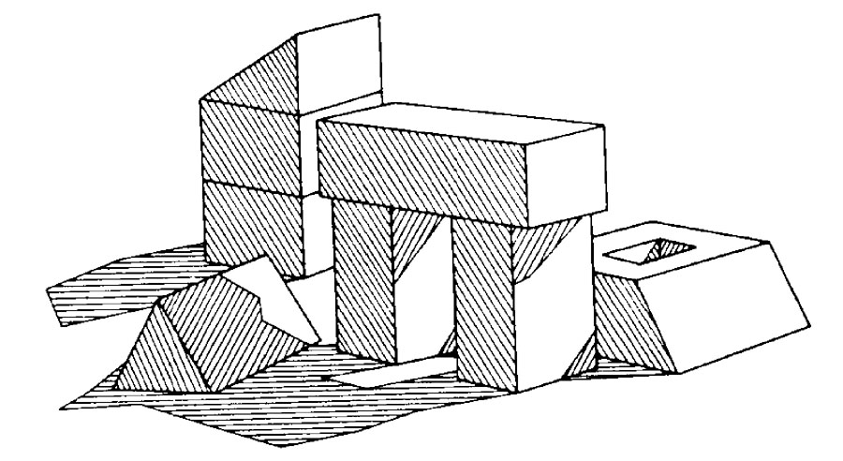
Shadows add complexity
CSP was able to label scenes where some
of the lines were caused by shadows

Slide 77
K-consistency
K-consistency generalizes arc consistency to sets of more than two variables.
  A graph is K-consistent if, for legal values of any K-1 variables in the graph, and for any Kth variable V_{k}, there is a legal value for V_{k}
Strong K-consistency = J-consistency for all J<=K
Node consistency = strong 1-consistency
Arc consistency = strong 2-consistency
Path consistency = strong 3-consistency

Slide 78
Why do we care?
If we have a CSP with N variables that is known to be strongly N-consistent, we can solve it without backtracking
For any CSP that is strongly K-consistent, if we find an appropriate variable ordering (one with “small enough” branching factor), we can solve the CSP without backtracking

Slide 79
Intelligent backtracking
Backjumping: if V_{j} fails, jump back to the variable V_{i} with greatest i such that the constraint (V_{i}, V_{j}) fails (i.e., most recently instantiated variable in conflict with V_{i})
Backchecking: keep track of incompatible value assignments computed during backjumping
Backmarking: keep track of which variables led to the incompatible variable assignments for improved backchecking

Slide 80
Challenges for constraint reasoning
What if not all constraints can be satisfied?
  Hard vs. soft constraints
  Degree of constraint satisfaction
  Cost of violating constraints
What if constraints are of different forms?
  Symbolic constraints
  Numerical constraints [constraint solving]
  Temporal constraints
  Mixed constraints

Slide 81
Challenges for constraint reasoning
What if constraints are represented intensionally?
  Cost of evaluating constraints (time, memory, resources)
What if constraints, variables, and/or values change over time?
  Dynamic constraint networks
  Temporal constraint networks
  Constraint repair
What if multiple agents or systems are involved in constraint satisfaction?
  Distributed CSPs
  Localization techniques

